Slide 1

AMRITA SCHOOL OF ARTIFICIAL INTELLIGENCE, BENGALURU
B. Tech in Artificial Intelligence and Data Science (AID)
Second Semester, Section F, Academic Year: 2023-24
INTRODUCTION TO MATERIAL INFORMATICS (23CHY115)
END-TERM PROJECT REPORT
ON
MACHINE LEARNING FOR THERMO ELECTRIC MATERIALS
Presented by Group No. 06
PADARTHI LEELA SABAREESH (BL.EN.U4AID23037)
KASTHURI NIKHILESH (BL.EN.U4AID23023)
BANDARU NITHIN KUMAR(BL.EN.U4AID23007)
MALIGI THANUJ KUMAR (BL.EN.U4AID23030)

Slide 2
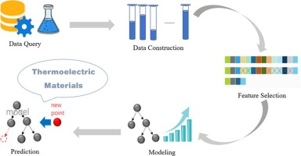
Introduction
Thermoelectric Materials:
Fig 1: ML in Thermoelectric Materials
Machine learning involves learning how to convert thermal energy in conducting materials into electricity and vice versa.
We use Machine learning algorithms are used to predict and identify new thermoelectric materials with improved performance by analyzing the relationship between material structure.

Slide 3
Objective:
XGBoost
Predicting Thermoelectric Efficiency:
Utilize XG Boost to expand a predictive model for thermoelectric performance primarily based on fabric properties. The aim is to accurately forecast the overall performance of new thermoelectric materials by schooling the version on a dataset comprising known fabric traits and their corresponding performance metrics.
Feature Importance Analysis:
Apply XG Boost to perceive the maximum vital capabilities influencing thermoelectric performance. By leveraging the version's capability to provide function importance rankings, researchers can gain insights into which fabric houses (e.g., electrical conductivity, thermal conductivity, See beck coefficient) are most impactful in figuring out performance.

Slide 4
Objective:
Random Forest:
Classifying Material Types:
Using Random Forest to classify unique kinds of thermoelectric materials into categories (e.g., excessive, medium, low efficiency) based on their physical and chemical residences. The objective is to automate the categorization system to assist within the rapid screening of capacity thermoelectric substances.
Predictions:
Develop an ensemble version with Random Forest to improve the robustness and accuracy of predictions concerning thermoelectric fabric houses. By aggregating the predictions from more than one selection bushes, the model ambitions to provide more reliable and strong predictions, mitigating the danger of overfitting and improving generalization to unseen records.

Slide 5
Data Details :
Data Collection and Structure:
The dataset consists of 1000 data files, each representing a different material structure. The structures include cubic, hexagonal, monoclinic, orthorhombic, tetragonal, triclinic, and trigonal materials. These files are:
cubic.xlsx
hexagonal.xlsx
monoclinic.xlsx
orthorhombic.xlsx
tetragonal.xlsx
triclinic.xlsx
trigonal.xlsx
Each file contains rows of observations with the following features and target variables:
Features: Columns 1 to 26, which include various physical and chemical properties of the materials.
Target: Column 27, which represents the thermoelectric property to be predicted.
Identity Column: Added to differentiate between different material structures.

Slide 6
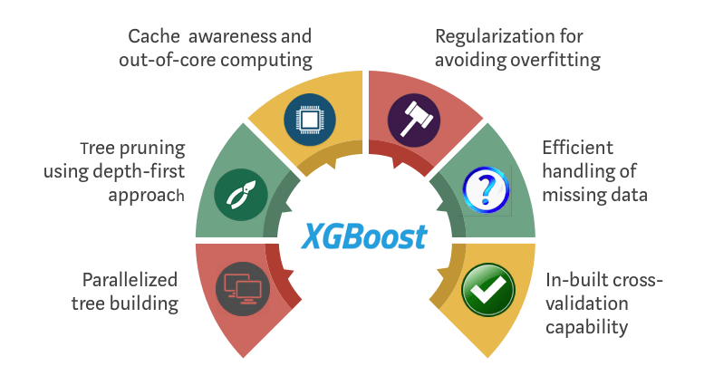
1.XGBoost:

Slide 7
XG Boost:
It is a powerful system gaining knowledge of algorithm widely used in numerous fields, inclusive of substances technology consisting of thermoelectric materials studies
XG Boost (extreme Gradient Boosting):
The XG Boost is an effective machine mastering set of rules broadly used in diverse fields, which include substances technological know-how which include thermoelectric materials studies. XG Boost belongs to the ensemble gaining knowledge of class and is specifically effective for regression and class tasks.
Feature Importance:
XG Boost affords a characteristic importance rating, indicating which enter capabilities contribute the maximum to the model's predictions. This perception is treasured in thermoelectric materials research for identifying the most influential factors affecting fabric overall performance.

Slide 8
Methodology
The Collection of Data:
Data source: 1000 data files were collected from various sources related to the research topic. Data files come in a variety of formats and types (structured and unstructured).
Data preprocessing: Data has been cleaned and normalized. Fixed missing values, removed duplicates, and performed feature engineering to create suitable features for model training.
Exploratory Data Analysis(EDA):
Statistical Analysis :
Conducted descriptive statistics to understand the distribution, central tendency, and variability of the data.
Visualization:
Used Visualization tools(e.g. scatter plots, box plots) to identify patterns, correlations, and outliers in the data.

Slide 9
Feature options:
Priority identification based on domain knowledge and EDA.
Importance: Techniques such as correlation matrices, mutual information, and importance features are used to select the most appropriate features from the samples (e.g. random forest).
Model development:
Reading Files: Reading each Excel file and process the data to extract relevant features and target variables.
Future and Target Extraction:
Extract Features from columns 1 to 26.
Extract the Target from column 27.
Add an identify column to identify the datasets each row belongs to.
Model Training:
XGBoost images:
Application: The XGBoost algorithm was used to train 1000 data files.

Slide 10
Random forest sampling:
Application:
Random Forest algorithm was used randomly sampling from 1000 data files.
Training: The model was trained on the simulated data.
Sample Analysis:
Metrics: The performance of both models was evaluated using metrics such as accuracy, precision, recall, F1 score, and AUC-ROC.
Comparison: The performance parameters of the XG Boost and Random Forest models were compared to demonstrate the efficiency of the inputs.
Outcome Measures:
Miscellaneous results: Differences in results generated by XG Boost and Random Forest models were examined for the given input data.

Slide 11
Implementation Details:
https://colab.research.google.com/drive/1tH3g2prdlpwuU9lMoM6jhe4SBOdFKaSS#scrollTo=FrNOqIuXu9Zp
https://colab.research.google.com/drive/1Zu-yrtzdV8nh0bCf85ojhE0OYoAg_LfW#scrollTo=m1v02pGMjpEF

Slide 12
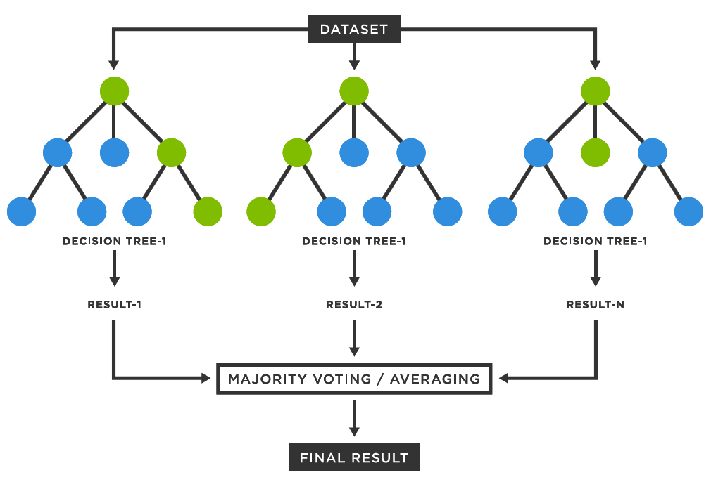
2.Random Forest

Slide 13
Random Forest:
It another famous system studying set of rules utilized in diverse domains, together with thermoelectric substances research. It belongs to the ensemble getting to know class, where a couple of decision timber are trained on exclusive subsets of the records and their predictions are blended to make a final prediction.
Property Prediction:
Random Forest may be utilized to expect the thermoelectric homes of substances based on input features which includes composition, shape, and experimental situations. By education on existing information, Random Forest fashions can capture complex relationships between enter functions and cloth homes, permitting correct predictions.
Feature Importance:
Random Forest presents a measure of feature importance, indicating which enter functions contribute the most to the version's predictions. This facts is treasured for researchers in thermoelectric substances to identify key elements influencing cloth performance.

Slide 14
Conclusion:
XG Boost and Random Forest, Both fashions had been skilled and evaluated the usage of a comprehensive dataset containing one thousand files representing diverse crystallographic systems together with cubic, hexagonal, monoclinic, orthorhombic, tetragonal, triclinic, and trigonal structures
Pre-processing data:
We loaded the data sets and processed them by extracting relevant features and target variables.
Features were amplified in the identification column to distinguish between data sets.
The data sets were filtered based on specific doping values ​​and temperature limits to highlight relevant data sets.
Random forest sampling:
It is trained on a pre-processed optimized data set.
The hyperparameters were tuned for efficiency.
The models were evaluated using the mean absolute error (MAPE) that reached sufficient accuracy to predict the thermoelectric performance.

Slide 15
XGBoost Model:
Though the unique implementation information are not provided within the precis, we assume comparable preprocessing and schooling methods were observed.
XGBoost, recognized for its sturdy dealing with of various datasets and pleasant-tuned hyperparameters, could additionally make a contribution to comparative evaluation.
OutCome Comparison:
Prediction accuracy: Both models demonstrated good prediction ability of thermoelectric properties. However, differences in the algorithmic approach may lead to differences in prediction accuracy and robustness.
Model performance: The random forest provided reliable predictions with acceptable MAPE, demonstrating its utility in understanding and predicting the behavior of radioactive materials
Random forests are useful for simplicity and interpretability.
XGBoost typically excels in dealing with large datasets with complex networks due to its boosting process.

Slide 16
References
[1] https://www.sciencedirect.com/science/article/abs/pii/S0927025621003529
[2] https://link.springer.com/chapter/10.1007/978-3-030-01418-6_39
[3] https://onlinelibrary.wiley.com/doi/full/10.1002/aelm.202300042
[4] https://pubs.acs.org/doi/full/10.1021/bk-2022-1416.ch001
[5]https://github.com/Vaitesswar/Machine_Learning_for_Thermoelectric_Materials/tree/main/Models/CGNN

Slide 17
Thank you

